Slide 1


Food Sales Predictions
By Tanner Gorman

Slide 2
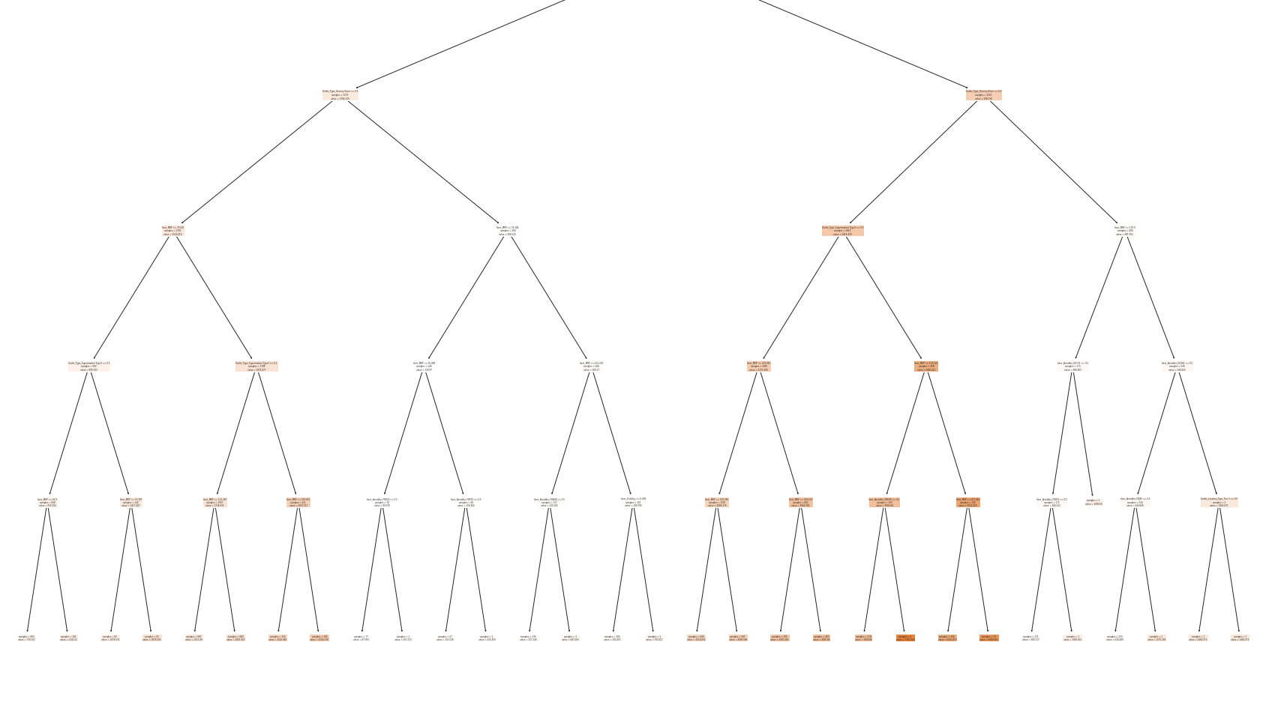
Learning Objectives
Understand Visualizations and predict future sales based on the following categories.
Item_Identifier---------------- Unique product ID
Item_MRP---------------------- Maximum retail price
Outlet_Location_Type----- Type of area Store is located
Outlet_Type------------------- Grocery store or Supermarket.
Item_Outlet_Sales----------- Sales of product in store.
Item_Visibility------------------ Percentage of visibility in store
Item_Type----------------------- Category of the product.

Slide 3
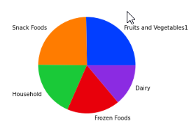
Top 5 Product distribution
Data is portrayed as a Pie chart between the top 5 listed items across all stores.
This helps us Identify top items and get a clear understanding of largest market typing's
In example fruits and vegetables & snack foods take up over 50 percent of top 5 Items featured.

Slide 4
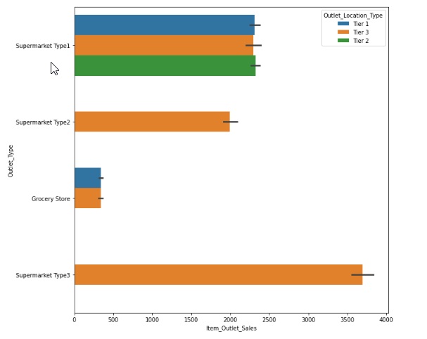
Final DATA VISUALIZATION
This is a bar representation of sales versus Outlet_Type.
We have a hue in place that breaks up the Outlet_Type by location .
This helps us identify things like what kind of outlet preforms statistically better based on location.
Here it can be seen that a supermarket type 1 preforms almost the same no matter the outlet location.
It also identifies room for improvement.
Grocery stores are in outlet location types 1 and 3 both have statistically more success in sales as a supermarket type one.
Based off this data I would recommend building upon each grocery store into a supermarket type one as outlet location appears to support both categories.

Slide 5
Summary
With data represented here there are clear and transparent areas of opportunity to maximize Item outlet sales.
With demographics on top products and performance of outlet location types it has been identified that there is clear room for improving on outlet types in tier 1 & 3 locations.

